Slide 1
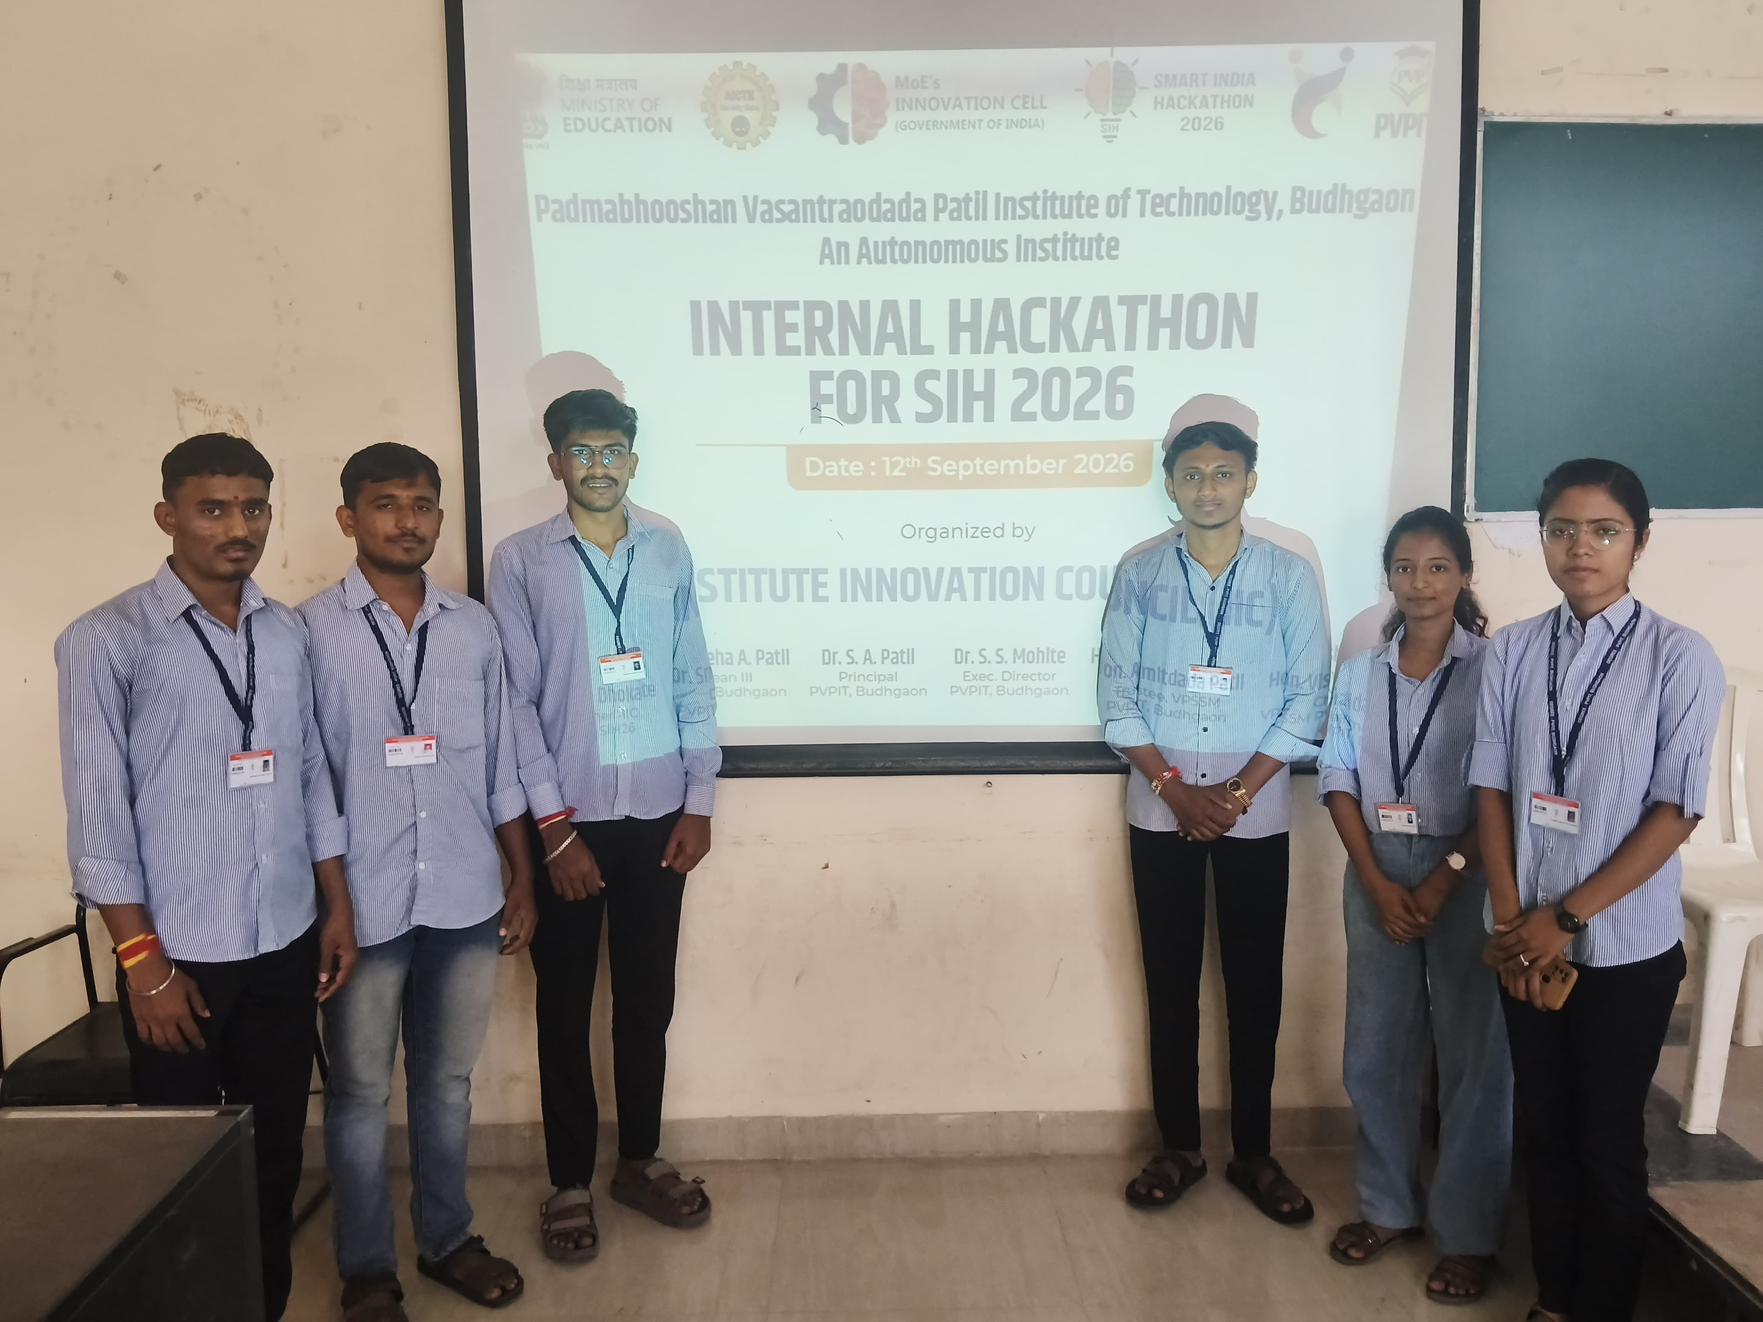

Slide 2

SMART INDIA HACKATHON 2025
Problem Statement ID – Self
Problem Statement Title - AI-Based Real-Time Human Threat Detection and Identification System for the Indian Army
Theme – AI-Based Human Threat Detection System
PS Category- Hardware
Team ID -
Team Name – Digital Warriors

Slide 3
IDEA TITLE
Digital Warriors
Email Scanner
PROBLEM STATEMENT :-
Real-time AI-based human threat detection system for identifying unusual or potentially dangerous situations using human presence sensors, camera-based AI analysis and instant local alerts. The system is designed as a compact, low-cost college prototype with a practical detection zone of about 1–2 metres
Solution:.
All-in-one compact human threat detection platform combining sensing, AI image analysis, alerts, location and optional wireless communication.
Email Scanner
URL/Website Analyzer
Browser Extension

Slide 4
TECHNICAL APPROACH
Digital Warriors
SENSING LAYER
SENSING LAYER
PIR motion sensor Human presence / movement 1–2 m demo zone Triggers camera analysis
NEO-6M GPS SX1278 LoRa Optional remote alert Outdoor location tag
ALL-IN-ONE HUMAN THREAT DETECTION PLATFORM
Real-time sensing • AI inference • alerts
PROCESSING
ALERT LAYER
Raspberry Pi 4 (4 GB) Python + OpenCV AI model / rule logic Local decision making
Buzzer + LED OLED status display Threat notification Human intervention

Slide 5
FEASIBILITY AND VIABILITY
Digital Warriors
TECHNICAL FEASIBILITY
ECONOMIC VIABILITY
OPERATIONAL VIABILITY
Raspberry Pi 4 can perform local Python/OpenCV processing.
PIR + camera provides a practical two-stage detection approach.
GPS and LoRa modules are widely available and easy to interface.
Target prototype budget: approximately ■7,000–■8,000.
Low-cost architecture supports scalable prototype deployment.
Suitable for student-level development and demonstrations
Simple workflow with fast local response.
Visual/audio alert supports immediate human intervention.
Modular and maintainable prototype design.
KEY CHALLENGES & MITIGATION
Low light / difficult scenes → use suitable lighting, camera placement and model preprocessing.
Power or connectivity limitations → local alerts remain functional; LoRa is optional for remote notification.
Privacy concerns → process images locally and avoid unnecessary cloud storage/transmission

Slide 6
IMPACT AND BENEFITS
Digital Warriors
Social Benefits
Economic Benefits
Environmental Benefits
Improves public and institutional safety.
Increases awareness of potential threats.
Supports faster emergency response.
Creates safer campus and community environments.
Low-cost and affordable prototype.
Reduces manual monitoring costs.
Uses easily available components.
Can be scaled to multiple locations.
Improves public and institutional safety.
Increases awareness of potential threats.
Supports faster emergency response.
Creates safer campus and community environments.
Impact
Early detection of suspicious activity.
Faster response to potential threats.
Useful for campuses, institutions and public areas.
Reduces the need for continuous manual monitoring.

Slide 7
RESEARCH AND REFERENCES
Digital Warriors
“You Only Look Once (YOLOv8) Based Intrusion Detection System for Physical Security and Surveillance” – IEEE, 2024
“YOLOv8: A Novel Object Detection Algorithm with Enhanced Performance and Robustness” – IEEE, 2024
“Fast and High-Precision Human Fall Detection Using Improved YOLOv8 Model” – IEEE Access, 2025
“Human Detection in Thermal Images Using YOLOv8 for Search and Rescue Missions” – IEEE“
A YOLOv8 Approach for Personal Protective Equipment (PPE) Detection to Ensure Workers’ Safety” – IEEE, 2024

